Slide 1
Camera Models class 8
Multiple View Geometry
Comp 290-089
Marc Pollefeys

Slide 2
Content
Background: Projective geometry (2D, 3D), Parameter estimation, Algorithm evaluation.
Single View: Camera model, Calibration, Single View Geometry.
Two Views: Epipolar Geometry, 3D reconstruction, Computing F, Computing structure, Plane and homographies.
Three Views: Trifocal Tensor, Computing T.
More Views: N-Linearities, Multiple view reconstruction, Bundle adjustment, auto-calibration, Dynamic SfM, Cheirality, Duality

Slide 3
Multiple View Geometry course schedule
(subject to change)
Jan. 7, 9 | Intro & motivation | Projective 2D Geometry
Jan. 14, 16 | (no class) | Projective 2D Geometry
Jan. 21, 23 | Projective 3D Geometry | (no class)
Jan. 28, 30 | Parameter Estimation | Parameter Estimation
Feb. 4, 6 | Algorithm Evaluation | Camera Models
Feb. 11, 13 | Camera Calibration | Single View Geometry
Feb. 18, 20 | Epipolar Geometry | 3D reconstruction
Feb. 25, 27 | Fund. Matrix Comp. | Structure Comp.
Mar. 4, 6 | Planes & Homographies | Trifocal Tensor
Mar. 18, 20 | Three View Reconstruction | Multiple View Geometry
Mar. 25, 27 | MultipleView Reconstruction | Bundle adjustment
Apr. 1, 3 | Auto-Calibration | Papers
Apr. 8, 10 | Dynamic SfM | Papers
Apr. 15, 17 | Cheirality | Papers
Apr. 22, 24 | Duality | Project Demos

Slide 4
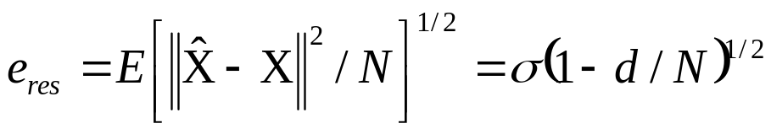
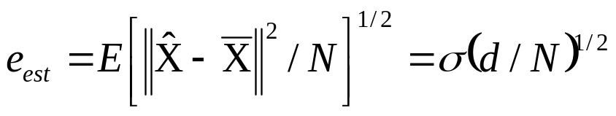
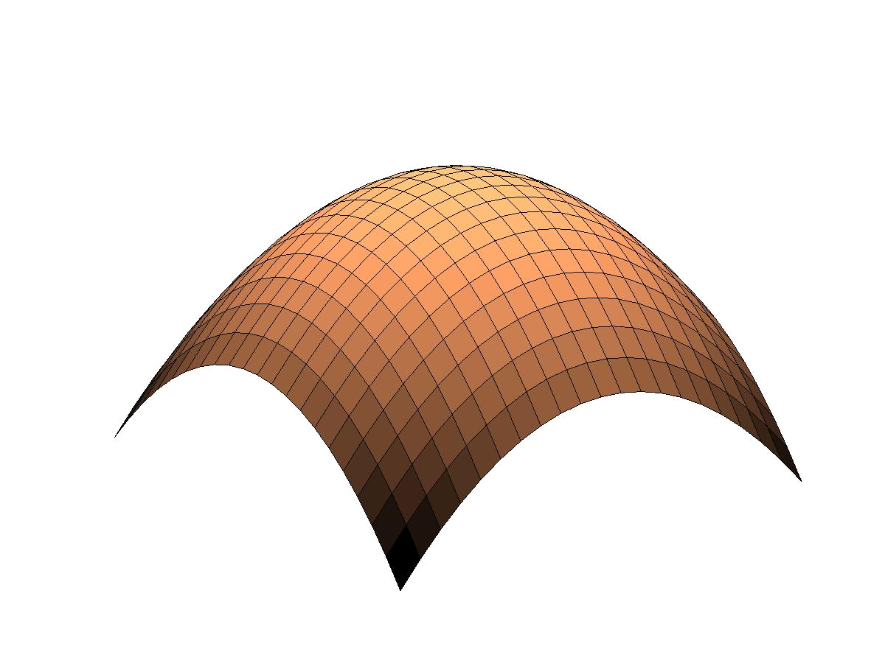

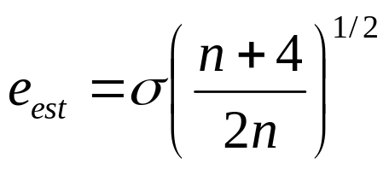
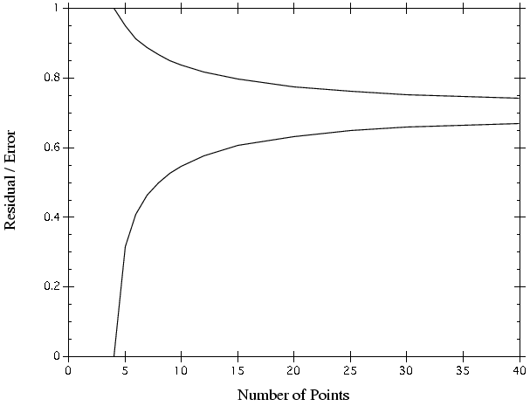
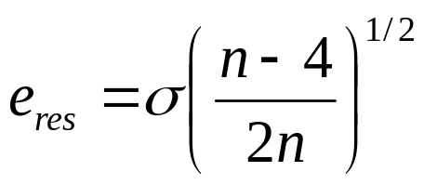
N measurements (independent Gaussian noise σ²)
model with d essential parameters
(use s=d and s=(N-d))
RMS residual error for ML estimator
RMS estimation error for ML estimator
X
Error in two images
n
X
X
S_{M}
Notes:
Note that these are lower bound for residual error against which a particular algorithm may be measured

Slide 5
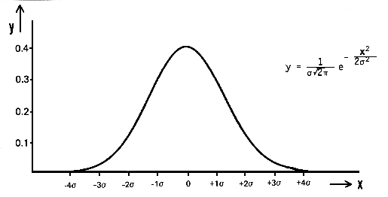
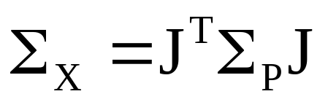
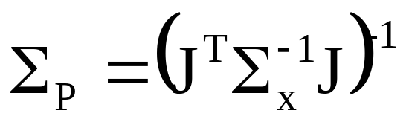
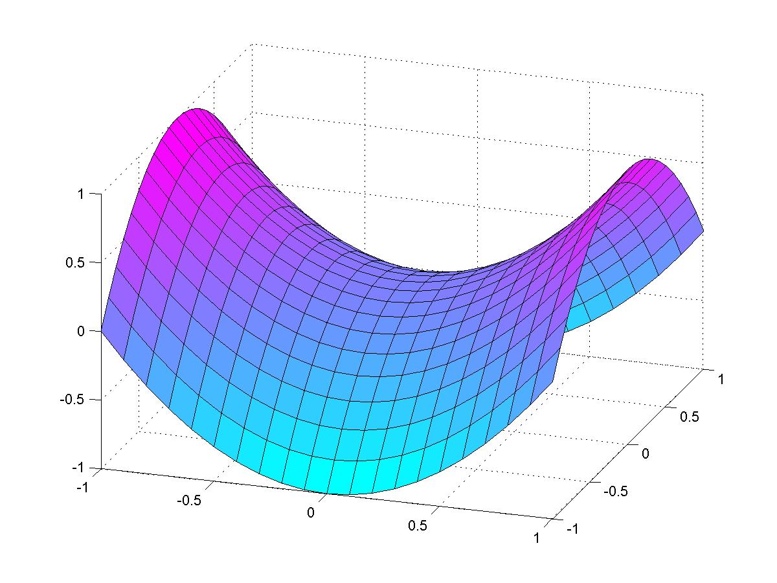
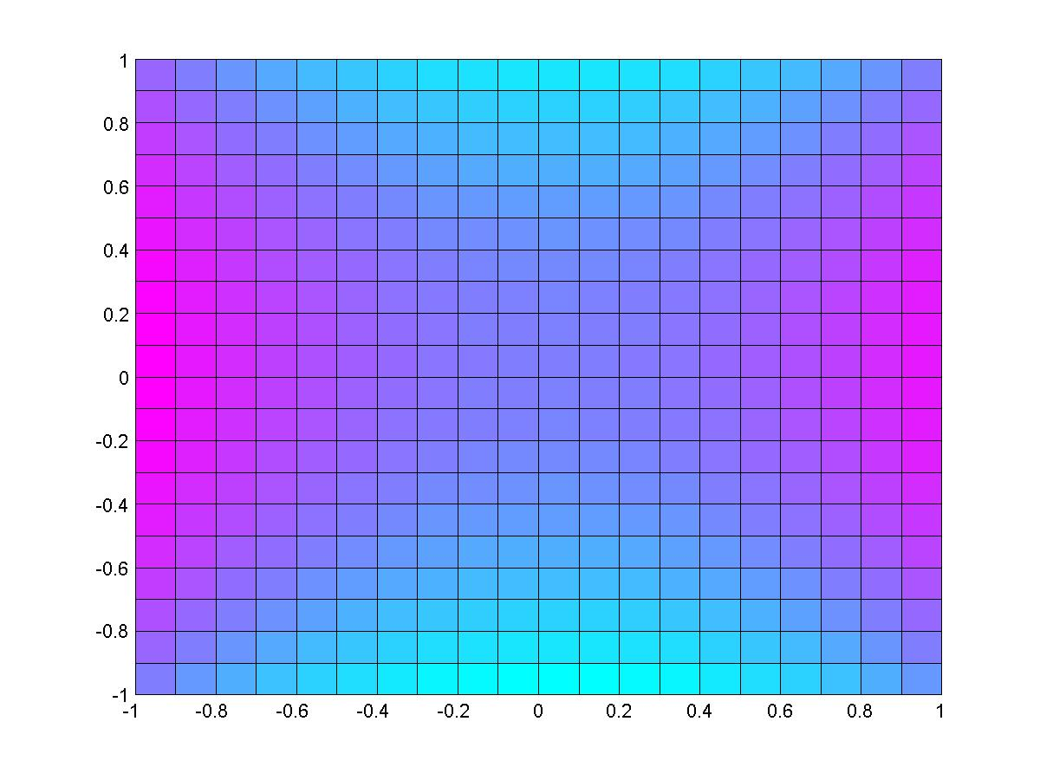
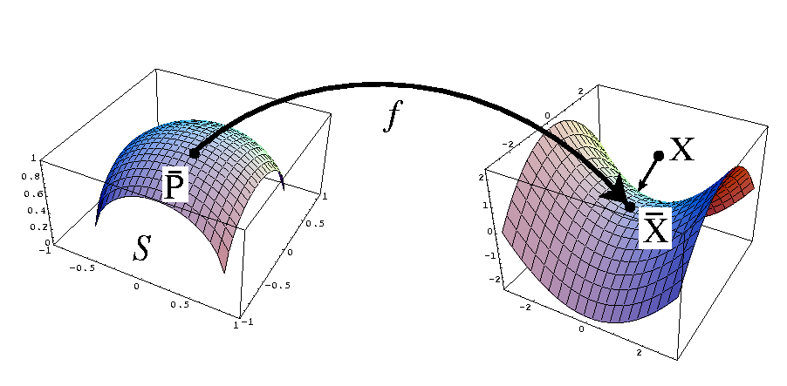

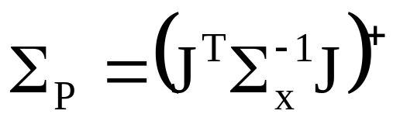
Forward propagation of covariance
J
f
v
Backward propagation of covariance
X
P
f ⁻¹
η
X
Over-parameterization
Monte-Carlo estimation of covariance

Slide 6
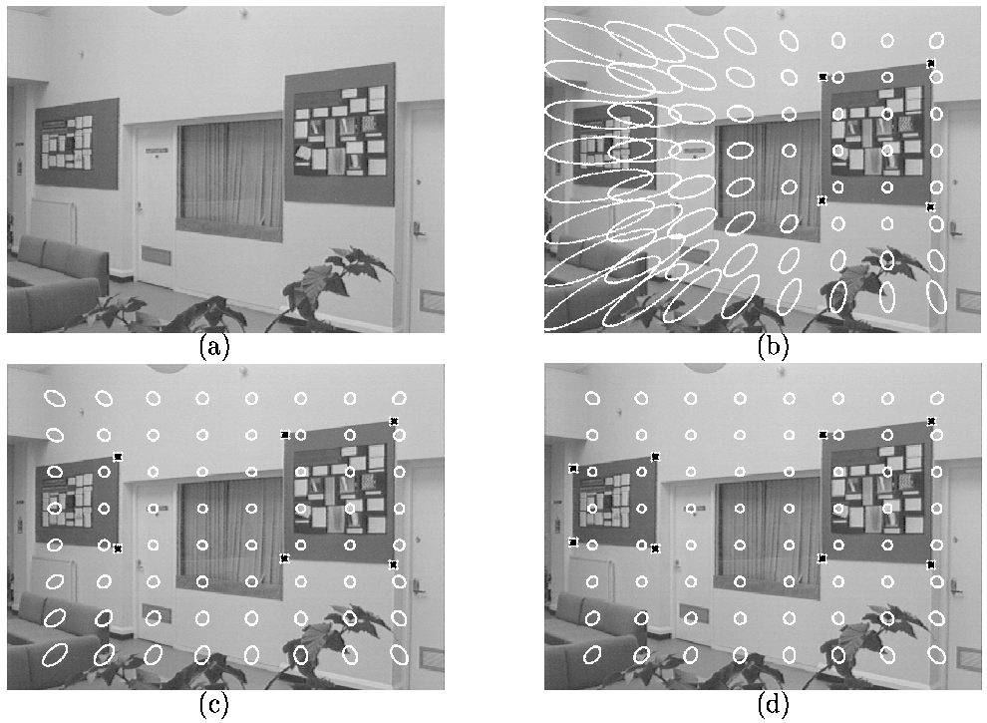
Example:
σ=1 pixel Σ=0.5cm
(Crimisi’97)

Slide 7
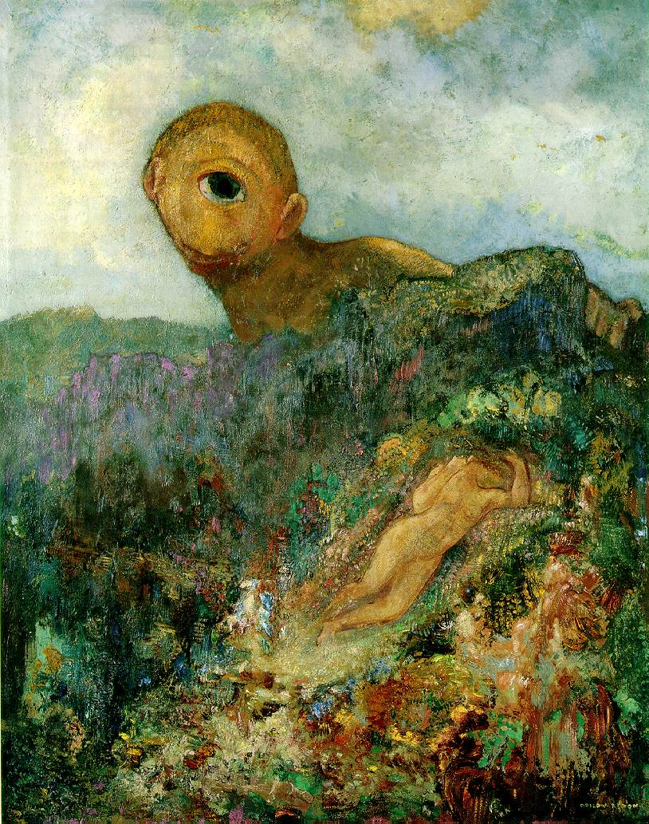
Single view geometry
Camera model
Camera calibration
Single view geom.

Slide 8
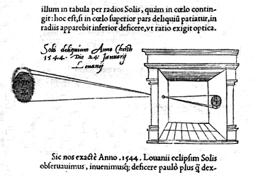

Slide 9
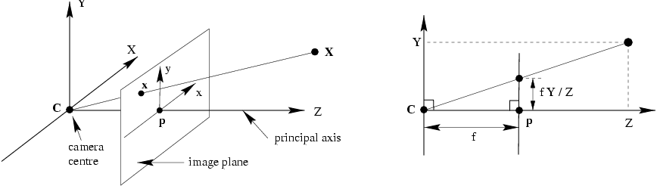
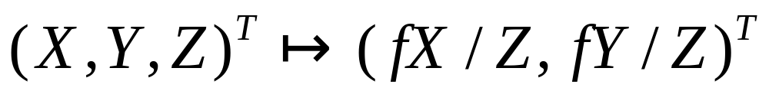
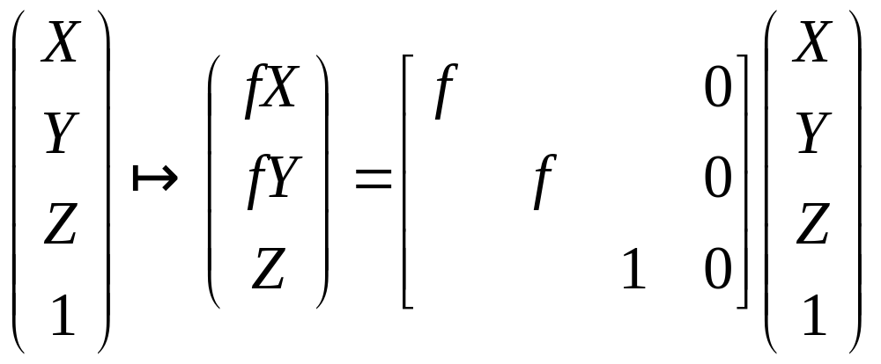
Pinhole camera model

Slide 10
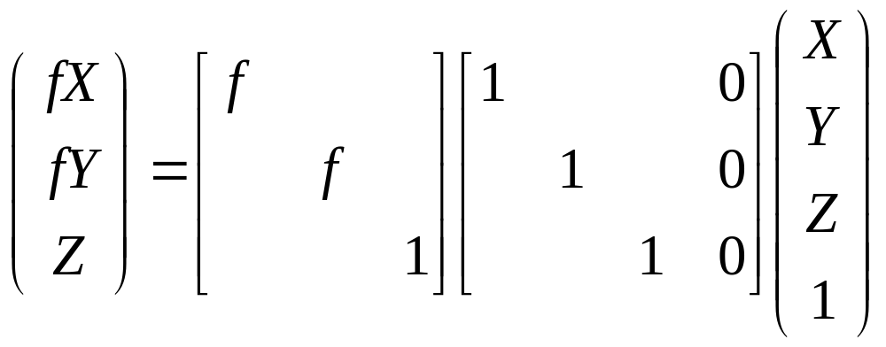
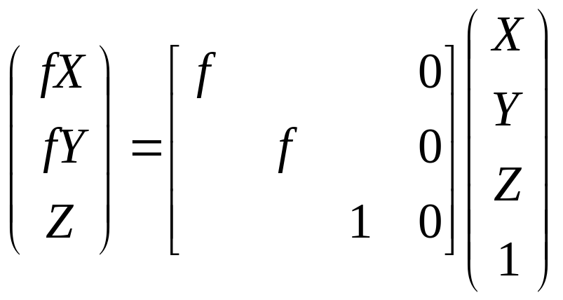

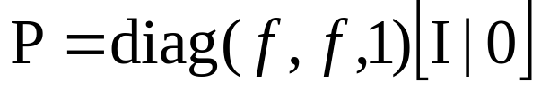
Pinhole camera model

Slide 11
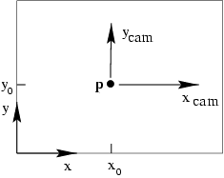
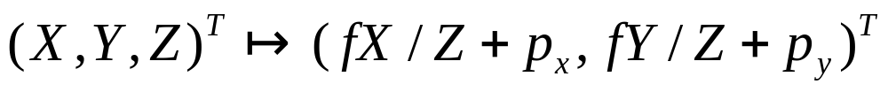
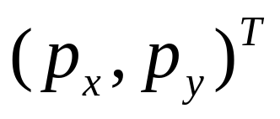
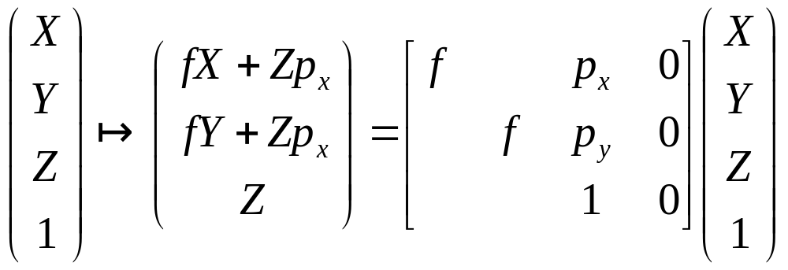
Principal point offset
principal point

Slide 12
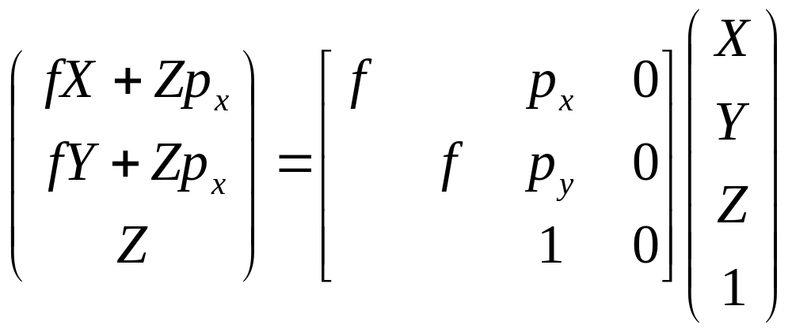
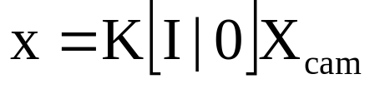
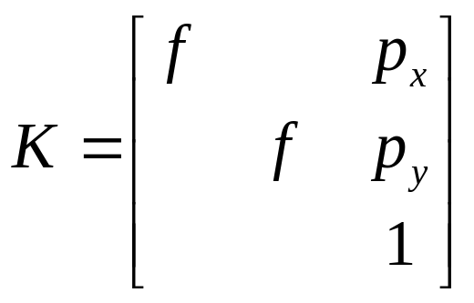
Principal point offset
calibration matrix

Slide 13
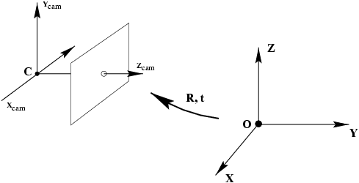
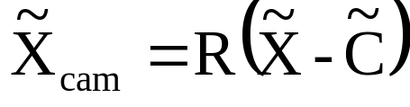
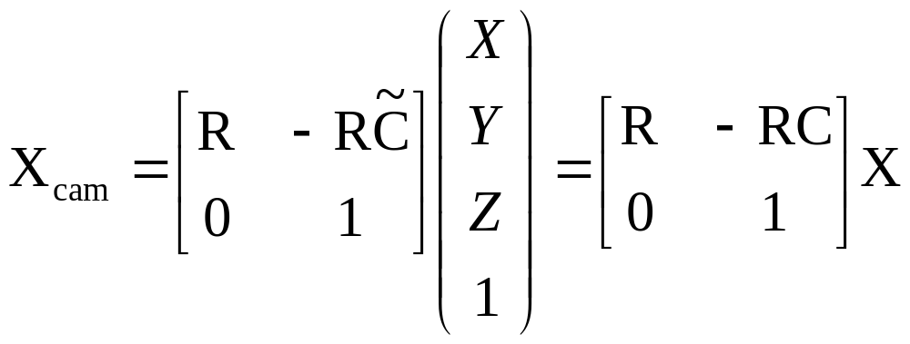
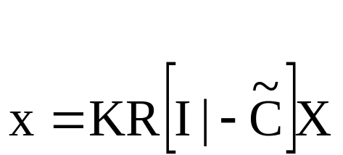
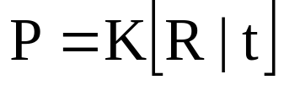
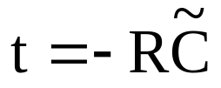
Camera rotation and translation

Slide 14
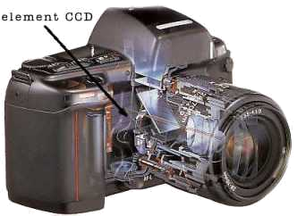
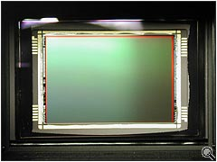
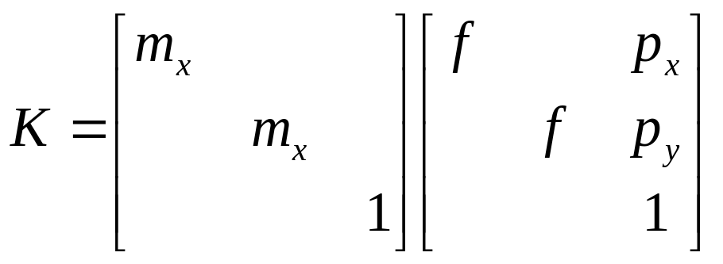
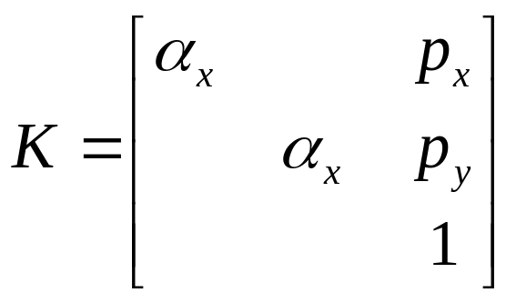
CCD camera

Slide 15
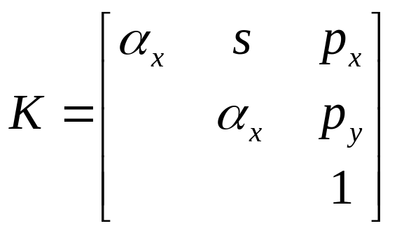
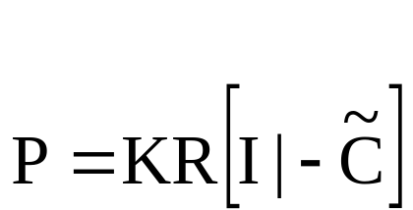
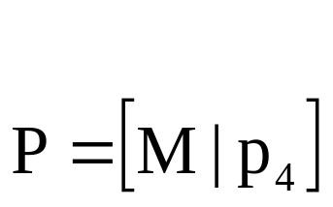
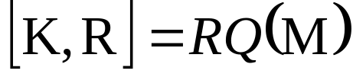
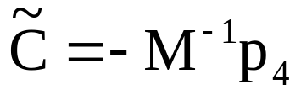
Finite projective camera
11 dof (5+3+3)
non-singular
decompose P in K,R,C?
{finite cameras}={P_{4x3} | det M≠0}
If rank P=3, but rank M<3, then cam at infinity

Slide 16
Camera anatomy
Camera center
Column points
Principal plane
Axis plane
Principal point
Principal ray

Slide 17

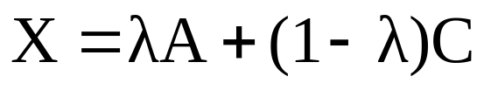
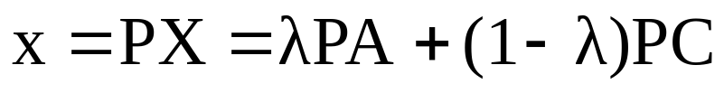
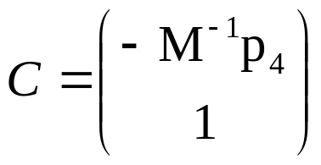
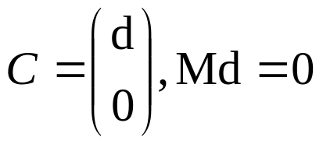
Camera center
null-space camera projection matrix
For all A all points on AC project on image of A,
therefore C is camera center
Image of camera center is (0,0,0)^{T}, i.e. undefined
Finite cameras:
Infinite cameras:

Slide 18
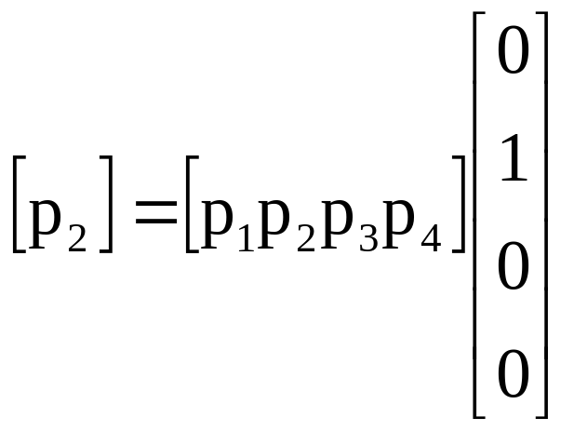
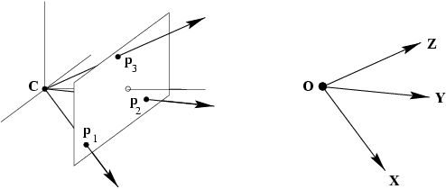
Column vectors
Image points corresponding to X,Y,Z directions and origin

Slide 19



Row vectors
note: p¹,p² dependent on image reparametrization

Slide 20



The principal point
principal point

Slide 21









The principal axis vector
vector defining front side of camera
(direction unaffected)
because

Slide 22










Action of projective camera on point
Forward projection
Back-projection
(pseudo-inverse)

Slide 23





Depth of points
(PC=0)
(dot product)
If ,
then m³ unit vector in positive direction

Slide 24





Camera matrix decomposition
Finding the camera center
(use SVD to find null-space)
Finding the camera orientation and internal parameters
(use RQ decomposition ~QR)
(if only QR, invert)
=( )⁻¹= ⁻¹ ⁻¹
Q
R
R
Q

Slide 25

When is skew non-zero?
arctan(1/s)
1
γ
for CCD/CMOS, always s=0
Image from image, s≠0 possible
(non coinciding principal axis)
resulting camera:

Slide 26

Euclidean vs. projective
general projective interpretation
Meaningfull decomposition in K,R,t requires Euclidean image and space
Camera center is still valid in projective space
Principal plane requires affine image and space
Principal ray requires affine image and Euclidean space

Slide 27


Cameras at infinity
Camera center at infinity
Affine and non-affine cameras
Definition: affine camera has P^{3T}=(0,0,0,1)

Slide 28



Affine cameras

Slide 29



Affine cameras
modifying p₃₄ corresponds to moving along principal ray

Slide 30


Affine cameras
now adjust zoom to compensate

Slide 31








Error in employing affine cameras
point on plane parallel with principal plane and through origin, then
general points

Slide 32

Affine imaging conditions
Approximation should only cause small error
Δ much smaller than d₀
Points close to principal point
(i.e. small field of view)

Slide 33




Decomposition of P∞
absorb d₀ in K_{2x2}
alternatives, because 8dof (3+3+2), not more

Slide 34


Summary parallel projection
canonical representation
calibration matrix
principal point is not defined

Slide 35



A hierarchy of affine cameras
Orthographic projection
(5dof)
Scaled orthographic projection
(6dof)

Slide 36


A hierarchy of affine cameras
Weak perspective projection
(7dof)

Slide 37



A hierarchy of affine cameras
Affine camera
(8dof)
Affine camera=camera with principal plane coinciding with Π∞
Affine camera maps parallel lines to parallel lines
No center of projection, but direction of projection P_{A}D=0
(point on Π∞)

Slide 38




Pushbroom cameras
(11dof)
Straight lines are not mapped to straight lines!
(otherwise it would be a projective camera)

Slide 39


Line cameras
(5dof)
Null-space PC=0 yields camera center
Also decomposition

Slide 40

Next class: Camera calibration

